Slide 1
Solar Energy Tree
Pragmatic Innovations and Designs Ltd.
Simultaneously collecting
thermal and photovoltaic
energy
Patent pending with USPTO
Email: designs@PragmaticInnovationsLtd.com

Slide 2
Presentation steps
Introduction
Summary of current solar technologies
Why do we need a new approach?
What is new?
What can we achieve?

Slide 3
Three patents granted by the USPTO in 2004, 2012 and 2015

Slide 4
Executive Summary: Solar Energy Tree
Will bring the cost of solar energy at par or lower than hydro, nuclear and coal by:
Increasing the efficiency of solar panels
Simultaneously collecting thermal and photovoltaic energy in a simple manner
Is based on two simple scientific principles
Light reflects multiple times between two reflective parallel surfaces
Hot air rises
Does not interfere with any ecosystem, air, water, habitats, etc.
Patent pending in the US
Will simultaneously protect the environment and the economy

Slide 5
Electromagnetic spectrum
Visible spectrum is small portion of the full spectrum
https://en.wikipedia.org/wiki/Light

Slide 6
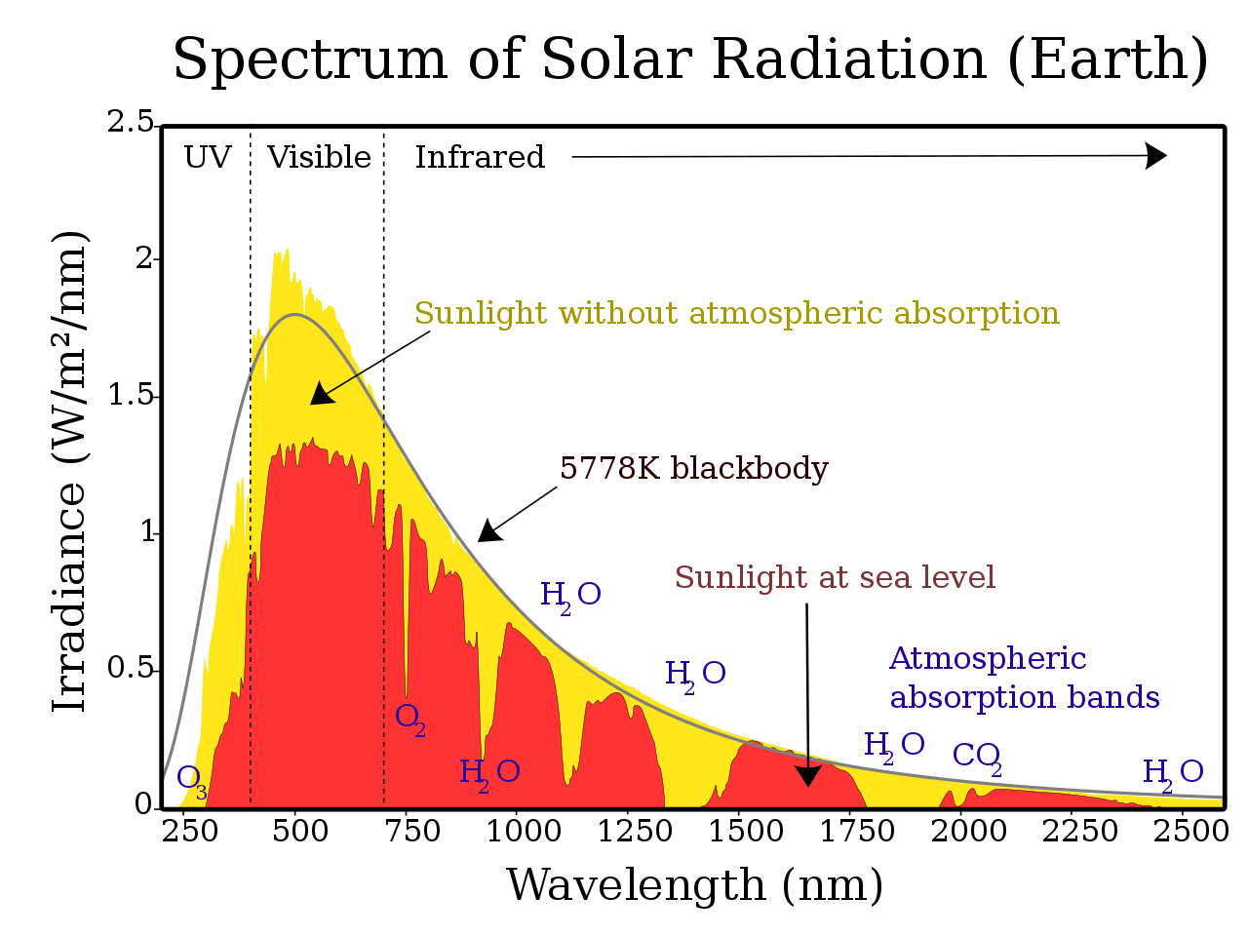
Solar Panels
Conventional solar panels can convert 18% of only the photovoltaic portion of the visible solar spectrum into usable electricity. These panels do not absorb any thermal energy.
Solar panels
Source: https://en.wikipedia.org/wiki/Sunlight

Slide 7
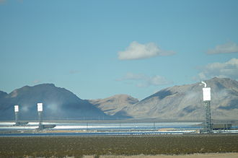
Solar Power Tower
Ivanpah Solar Power Tower: Collects thermal energy via light reflection and steam turbines
Source: https://en.wikipedia.org/wiki/Ivanpah_Solar_Power_Facility
Source: https://en.wikipedia.org/wiki/Sunlight

Slide 8
Two isolated systems to collect solar energy
Ivanpah Solar Power Tower: Collects thermal energy via light reflection and steam turbine
Solar panels
Source: https://en.wikipedia.org/wiki/Ivanpah_Solar_Power_Facility

Slide 9
Comparison of two isolated solar energy systems
Description | Solar Panels | Solar Power Towers
Photovoltaic Energy | Yes | None
Thermal Energy | None | Yes
Efficiency | <20% | <20%
Cost competitive with established sources of electricity | No | No

Slide 10
How to make solar energy cost competitive?
Make solar panels more efficient
Simultaneously collect photovoltaic AND thermal energy
Do so in a simple manner
Can the Solar Energy Tree do that?
Let us see!

Slide 11
Solar Energy Tree
absorption capacity
SET can absorb a major % of the photovoltaic and thermal portions of the entire solar spectrum.
Source: https://en.wikipedia.org/wiki/Sunlight

Slide 12
Collecting photovoltaic energy with multiple reflections
Conventional Solar Panels:
One incidence, one reflection. Efficiency = X
Solar Energy Tree: Multiple incidences, multiple reflections. Efficiency = 3.5X
100%
80%
Efficiency way more than 20%
Efficiency ~ 20%

Slide 13
Sun tracking
Conventional Solar Panels:
Source: Natural Resources Canada www.nrcan.gc.ca
Solar Energy Tree:
Constantly tracking sun efficiently
Solar Hours per day in Kingston:
Static panel: 4.38 hours
Dual axis tracker: 6.07 hours
Dual axis tracker ~40% more efficient, however quite expensive
A conical panel will receive sunlight from all directions
Due to multiple reflections, the angle of incidence is immaterial
Should be at least equivalent to dual axis tracking system. Efficiency = 1.4X

Slide 14
Protection from the elements
Conventional solar panels:
Are constantly exposed to the elements
Solar Energy Tree: panels are constantly protected with a clear shell
Air flow to remove dust
Dust
Steeper incline

