Slide 1
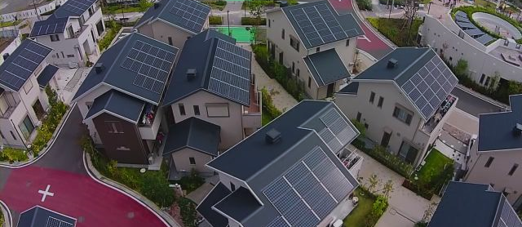

SWITCH Event
Sylvie Briz
Feb 3, 2017
RESIDENTIAL SOLAR +
ENERGY STORAGE
Fujisawa, Japan
Panasonic’s Smart Sustainable Town
BROUGHT TO YOU BY

Slide 2
Outline
Panasonic and current solar + storage offering
Value proposition
How the system works
Selecting back up loads
Solar + storage installations in Ontario
Key Learning

Slide 3


ECO SOLUTIONS CANADA
LEADING ONTARIO’S SOLAR INDUSTRY
OVER 55MW AC / 70MW DC INSTALLED OR UNDERWAY
COMMERCIAL, RESIDENTIAL & COMMUNITY MICROGRID
COMPETITIVE PROJECT FINANCING, EPC, O&M SERVICES
RESIDENTIAL ENERGY STORAGE

Slide 4

Panasonic & Energy Storage
EXPERIENCE = RELIABILITY
Over 40 Years in Lithium-Based Storage
In the next decade, Lithium-ion will become mainstream…
more than 80% of global energy storage installations will include the technology by 2025.
- IHS Market, Energy Storage Report 2016

Slide 5
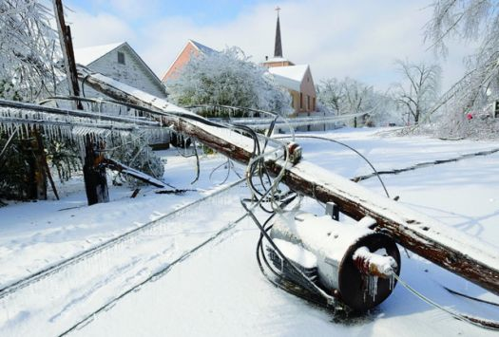
Context and Opportunity
Infrastructure deficits
Rising electricity rates
Increased severe weather
Increased grid outages
Near solar grid parity
Viability of storage:
$13.6B by 2025
Sample Outages:
  2016 Blackout: ~210,000 customers in Ontario, Quebec, New Brunswick
  2014: 18.8M customer hours of interruption (OEB)
  2013 Ice Storm: ~600,000 Ontario customers
  2006 Thunderstorm: ~250,000 Ontario customers
  Northeast Blackout of 2003: 10,000,000 Ontario customers

Slide 6



Homeowner Benefits of Solar plus Storage
Reduce Environmental
Impact
Monthly
Savings
Clean Backup
Power

Slide 7
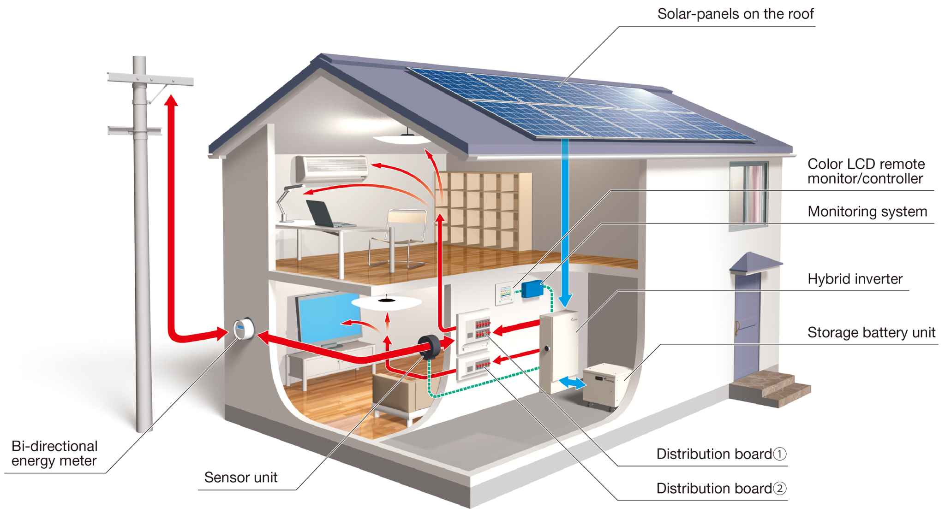
Key Components
Notes:
Solar PV: typically 25-27 panels, total 6-7kW
Hybrid Inverter
(Note: 3 MPPT – up to 3 strings to allow for different roof sides (south, west, east))
Battery: 10kWh lithium ion
(Stores energy from solar system or the grid)
(patented triple protection to prevent overheating)
Size: inverter is 2’ x 4’ x 10”, wall mounted, battery is ground mounted cube, less than 2’, (approx. size of a night table)
Sound: comparable to furnace
Bi-directional meter – accounts for both consumption and RE generation
Remote controller (see below)

Slide 8
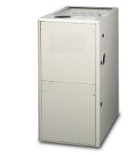
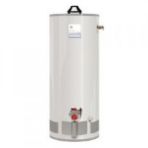
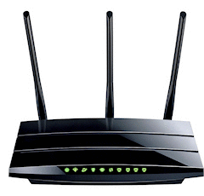
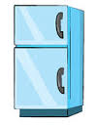

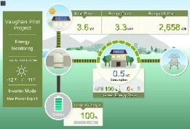

Selecting Backup Loads
Average | Monitoring | Lights | Furnace | Hot Water Tank | Internet | Fridge | Freezer
Avg. Wattage | 5 | 129.8 | 350 | 3500 | 50 | 500 | 350
Avg. Daily Hours | 24 | 3.33 | 5.3 | 3.93 | 24 | 3 | 2
Avg. Daily kWh | 0.12 | 0.43 | 1.87 | 13.7 | 1.2 | 2.5 | 0.7
Source: PESCA installed systems and Toronto Hydro

Slide 9
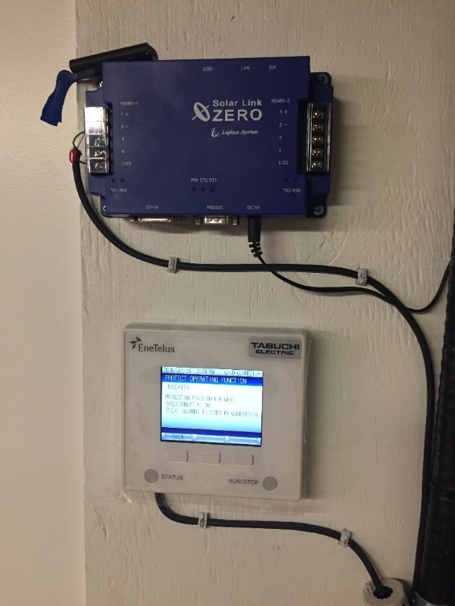
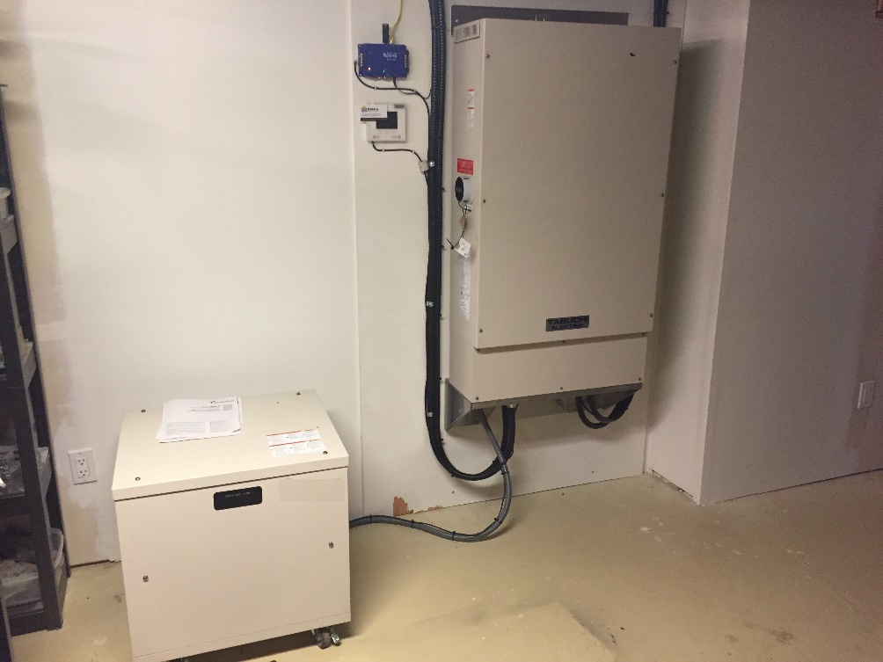
Inverter and Battery in the Basement

Slide 10
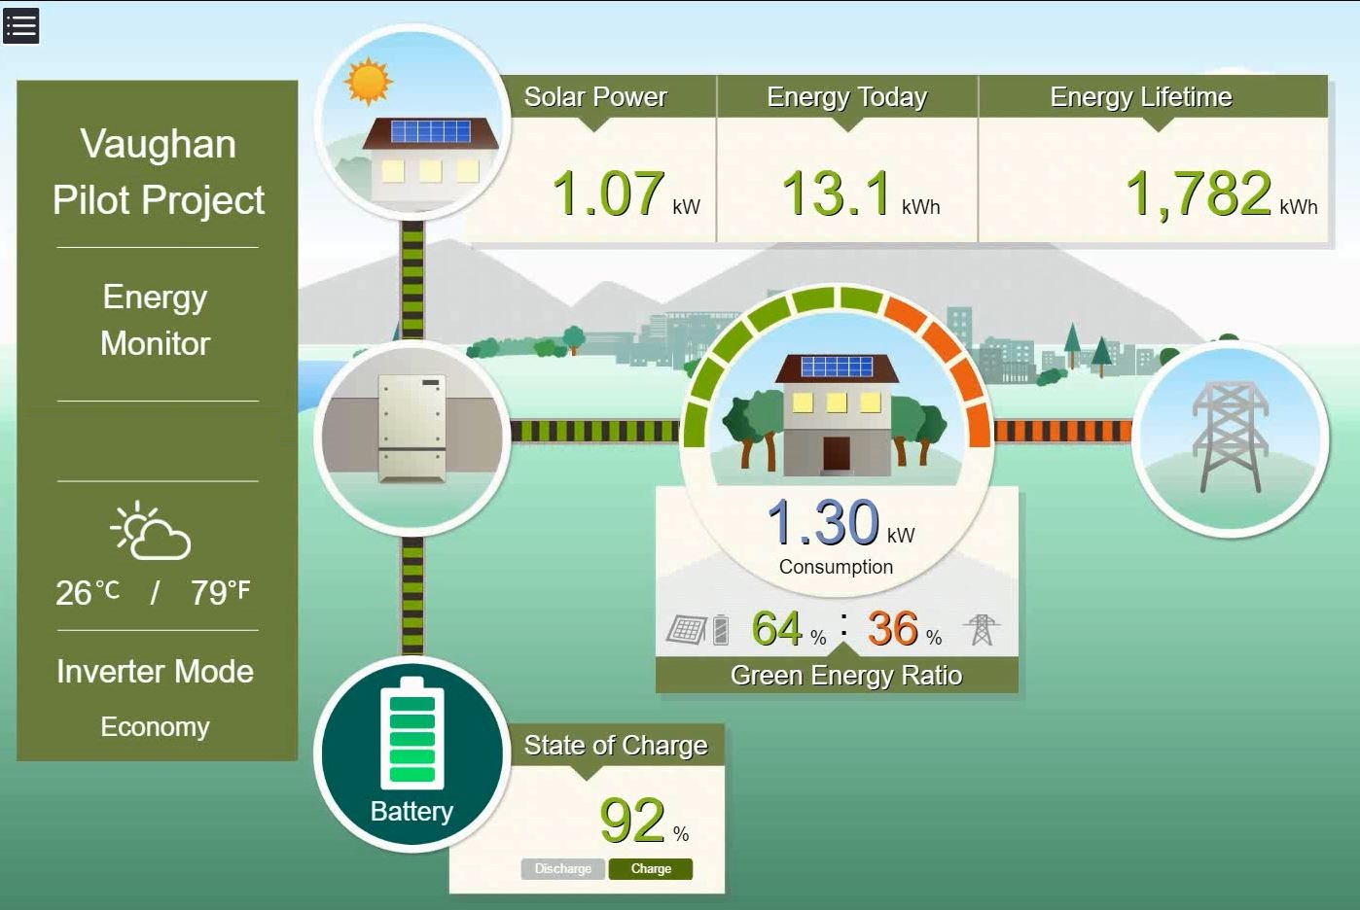
User-Friendly Monitoring

Slide 11
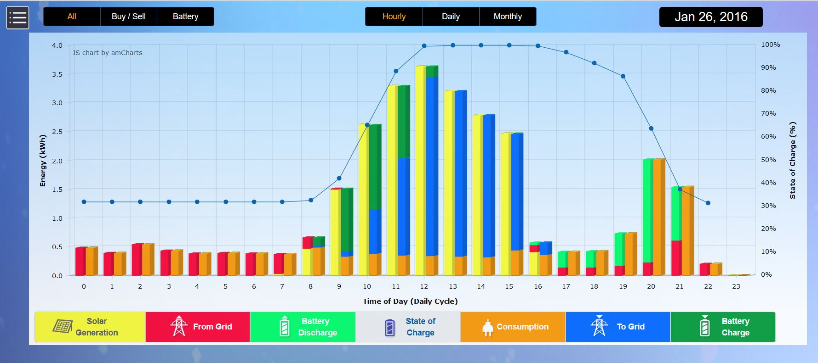
Detailed Views to Track Performance
Track Performance Hourly, Daily, Monthly and Over the System’s Lifetime

Slide 12
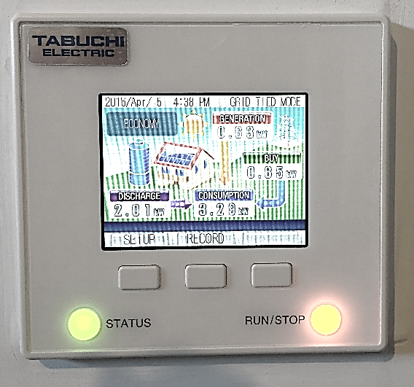
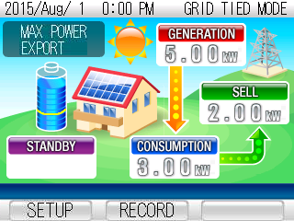
User-Friendly Remote Control
Simple, Thermostat Sized: Easily Set Time and Depth of Discharge

Slide 13
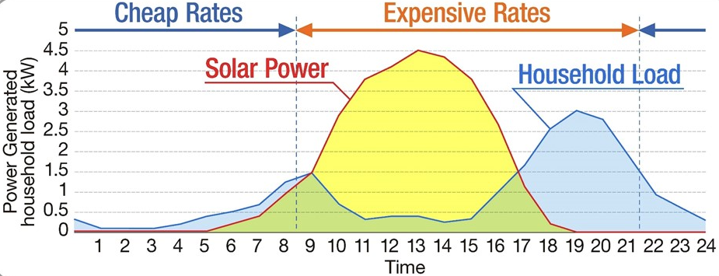
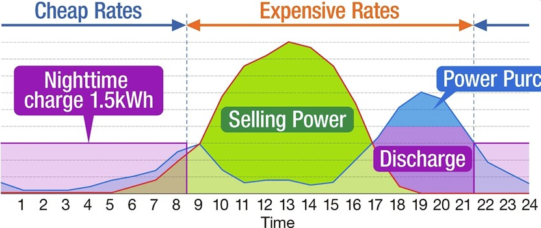
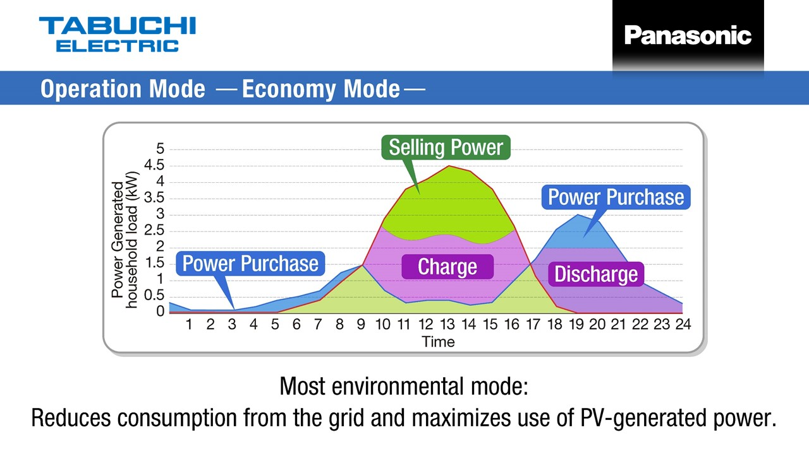
Flexible Operation Modes Provide Best ROI
Max Power
(Charge w/ Grid)
Economy
(Charge w/ Excess Solar)
Backup
(Maintain Full Charge)
The battery is charged from the Grid during the night.
  Daytime: Power is sold to the Grid.
  Peak-time: Battery use reduces Demand Charge.
  Night: Battery is charged by the Grid.
Notes:
Take control of energy needs – whether by exporting to the grid, using solar in the home, or ensuring the battery is fully charged (when you know the storm is coming)
Max power mode shown here

Slide 14
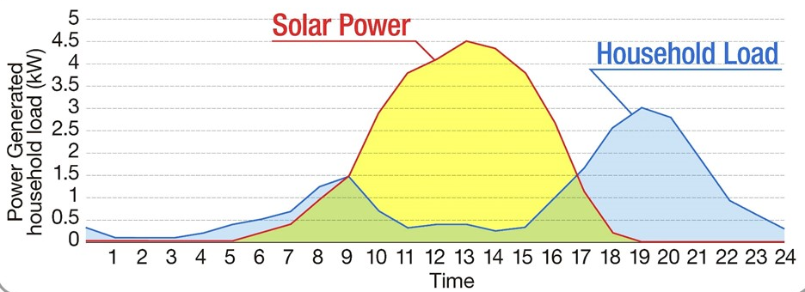
Flexible Operation Modes Provide Best ROI
Max Power
(Charge w/ Grid)
Economy
(Charge w/ Excess Solar)
Backup
(Maintain Full Charge)
Battery is charged by PV and excess power is sold to Grid.
  Daytime: PV charges the battery and excess power is sold to the Grid.
  Night: Power is supplied by the battery.
Notes:
Economy mode shown here
Also explain backup mode (no dedicated slide)

Slide 15
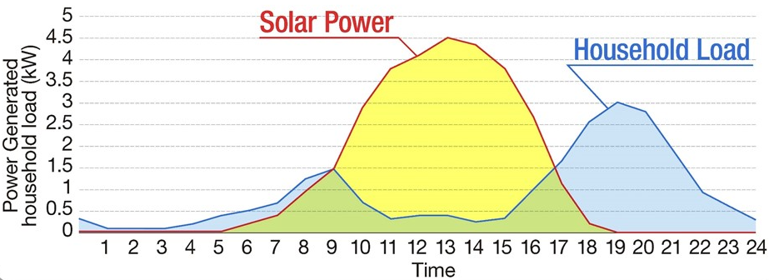
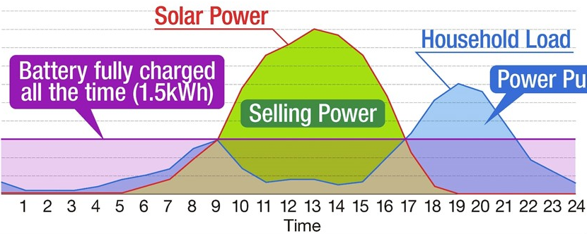
Flexible Operation Modes Provide Best ROI
Max Power
(Charge w/ Grid)
Economy
(Charge w/ Excess Solar)
Backup
(Maintain Full Charge)
Battery used only for grid outages
  Daytime: Power is sold to the Grid.
  Night: Power supplied by the Grid
  Once the battery is fully charged, it is only used in case of a grid outage.
Notes:
Economy mode shown here
Also explain backup mode (no dedicated slide)

Slide 16
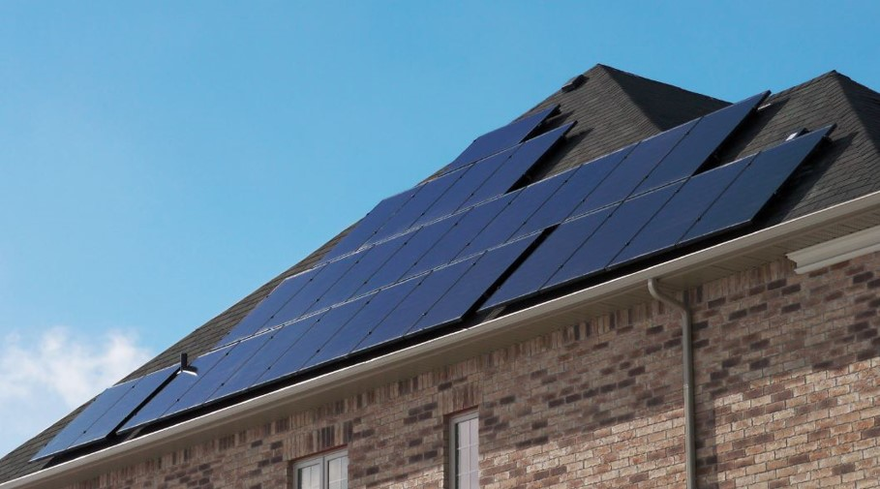
Residential Solar + Energy Storage Installations in Ontario

Slide 17
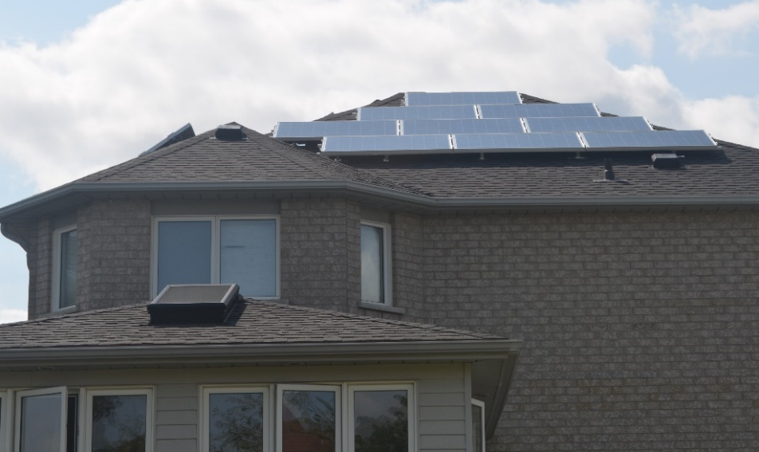
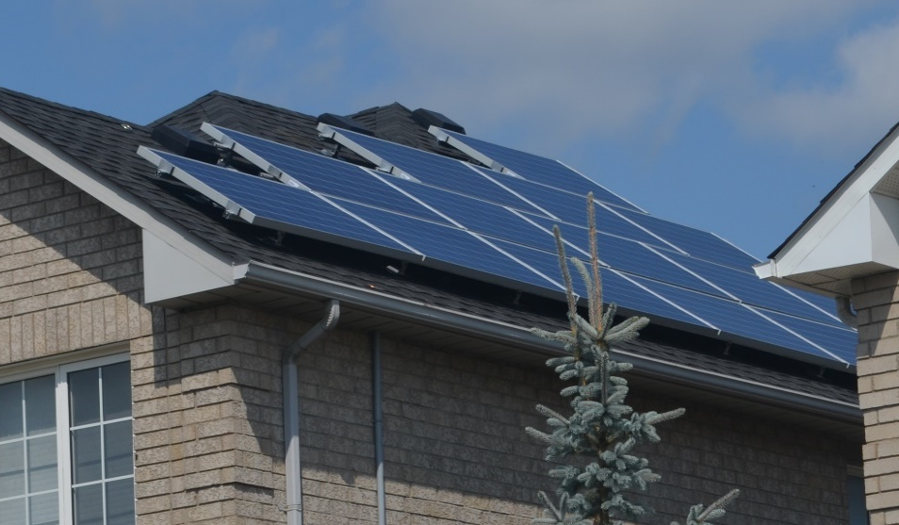
Pilot: Vaughan Project
First Installation in North America: Vaughan, ON
  Operating since September 2015
  6.25kW Solar Photovoltaic System
  Local Distribution Company (LDC): Powerstream
  Net Metered Tiered Pricing:
  9.9 – 11.6 ₵ / kWh

Slide 18
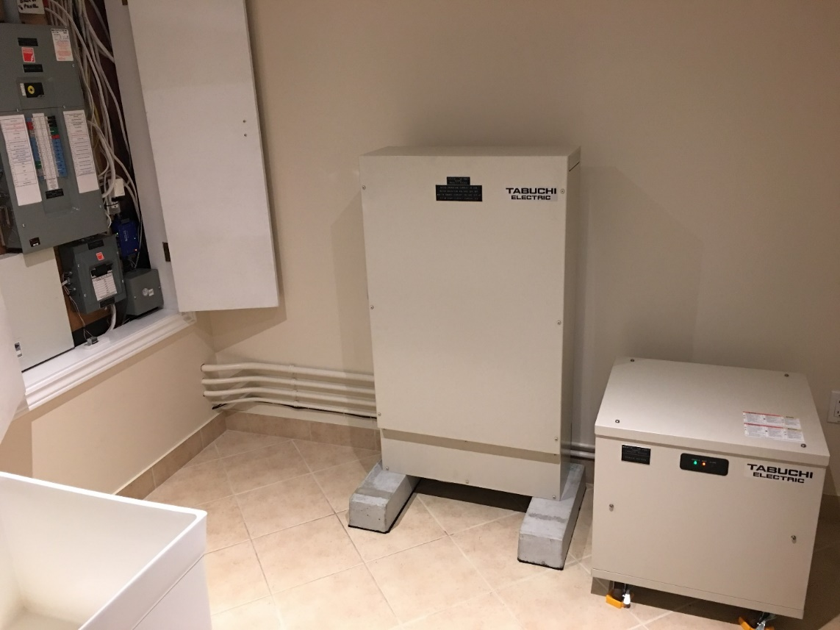
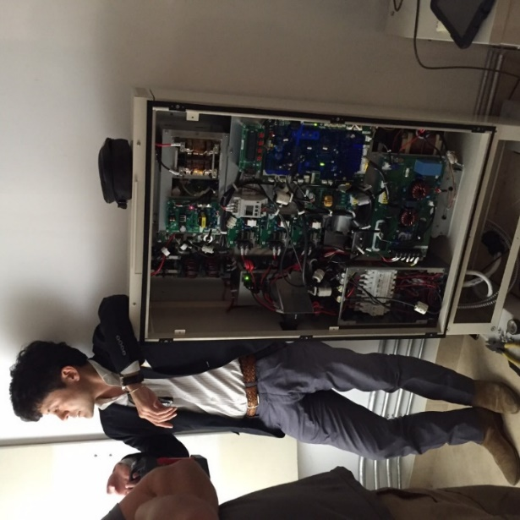
Pilot: Vaughan Project
First Installation in North America: Vaughan, ON
Both inverter and battery are installed in the basement

Slide 19
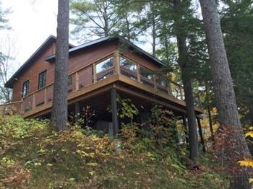
Cottage: Cottage in Bala
First Cottage Project in Muskoka
  Operating since October 2015
  6.75kW Solar Photovoltaic System
  LDC: Hydro One
  Cottage segment has unique loads eg. Water pumps, sewage pumps

Slide 20
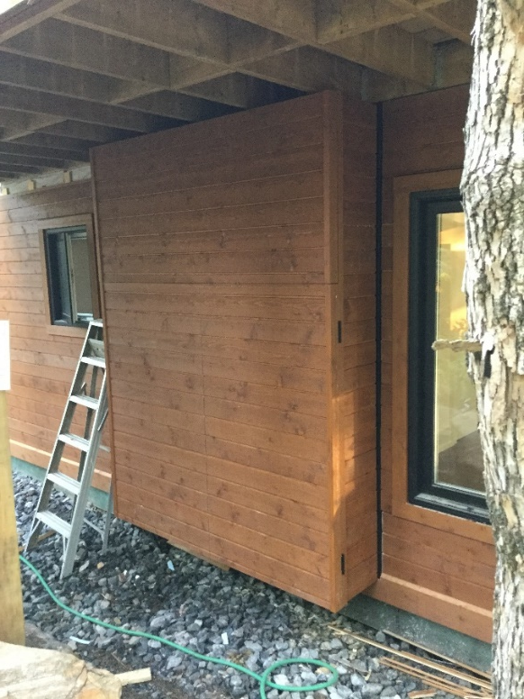
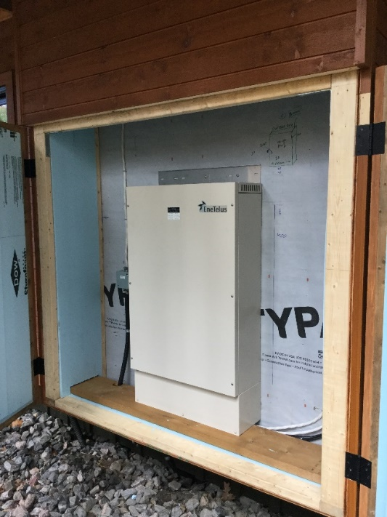
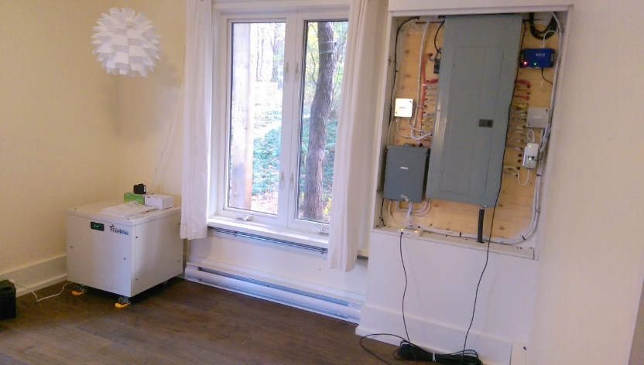
Cottage: Cottage in Bala
First Cottage Project in Muskoka
Inverter is installed in an enclosure outside the cottage, and battery is installed inside the cottage

Slide 21
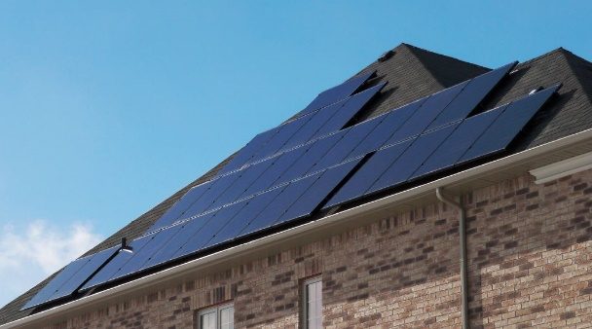
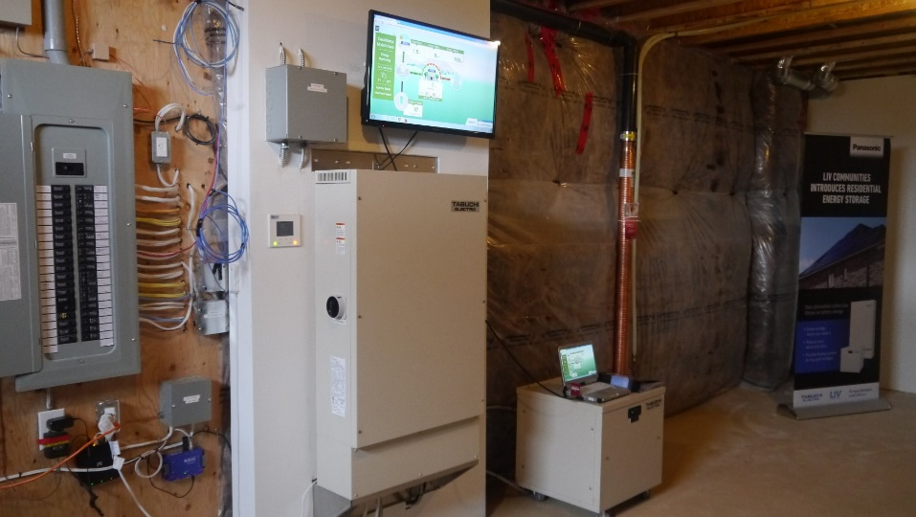
Builder: Casablanca Model Home
First Builder Project in a Model Home
  Operating since February 2016
  7.15kW Solar Photovoltaic System
  LDC: Hydro One Brampton
  Both inverter and battery are installed in the basement

Slide 22
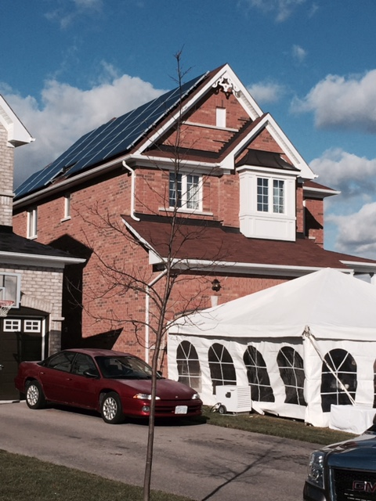
Utility Pilot: OPUC Pilot Project
First Utility Project
  First installed system is operating since November 2015
  30 residential homes in Oshawa
  Solar system sizes range from 5.36kW to 6.89kW
  LDC: Oshawa Power
  The objective of the project:
    To provide behind-the-meter generation, storage, back-up power supply and shifting demand away from on-peak
    To address power outages caused by extreme weather conditions, including ice storms.

Slide 23
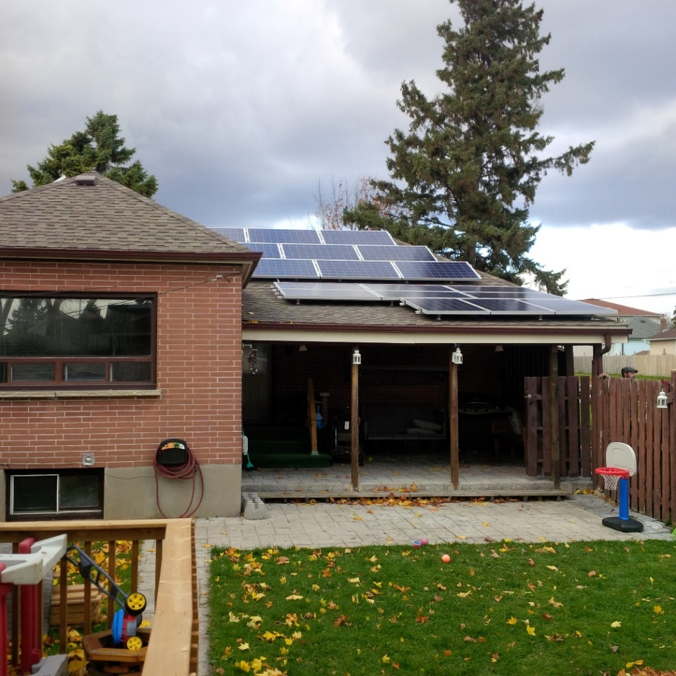
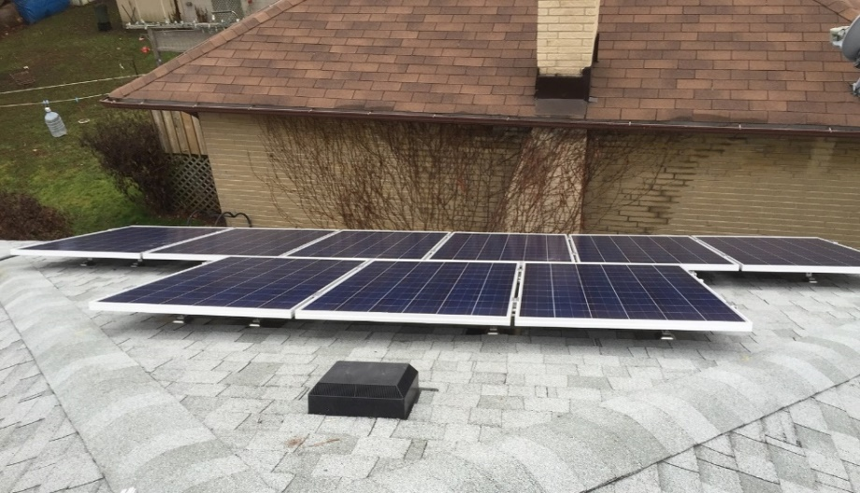
Utility Pilot: OPUC Pilot Project
First Utility Project
Installed Tabuchi system in both new and old homes, tested system using different sets of appliances, heating methods, lighting

Slide 24
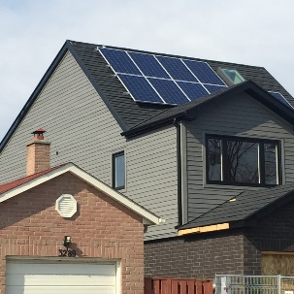

Project: Mike Holmes Jr.
New HGTV Series – Reno Featuring Solar + Storage
  6.63kW Solar Photovoltaic System
  LDC: EnerSource
  Started airing on Nov 10th
Notes:
-

Slide 25

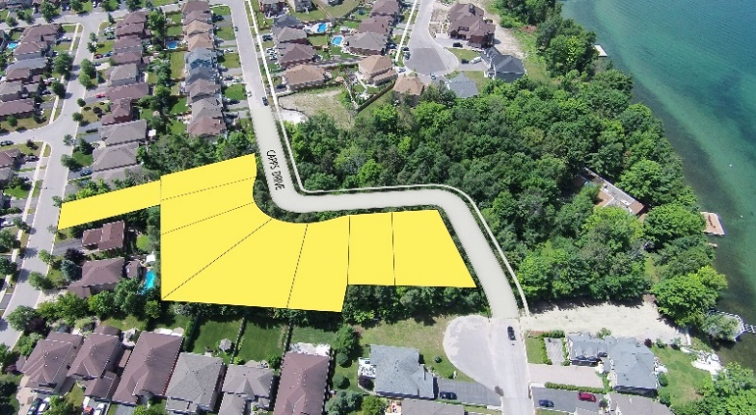
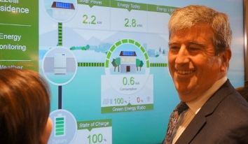
Case Study: Solar + Storage included with every home in Simcoe Shores Development in Barrie
Award-Winning Builder Embraces Solar + Energy Storage
  Simcoe Shores - Barrie, ON ⋅ 8 Detached Units ⋅ Launched in October 2015
  DAY ONE: SOLD OUT

Slide 26
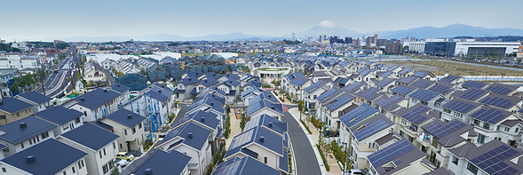

Sustainable Smart Communities
VISION: SUSTAINABLE SMART COMMUNITIES
Fujisawa City - Kanagawa, Japan Opened 2014: 600 Detached, 400 Apartments Sustainability Targets: 70% Reduction in CO₂ 30% Reduction in Water Consumption 30% Renewable Energy Use 3-Day Off-Grid Capability | Smart Services: Energy Security Health Community | Mobility Leisure Financial Management Asset Management
Notes:
Beyond this, our ability to lead on energy storage comes from nearly 100 years of human centered design – creating and delivering solutions to improve people’s lives around the world
Today we are offering you the opportunity to collaborate, to share in this vision, and become an agent for innovation and leadership here in Ontario. We hope you’ll share in our passion and enthusiasm, and take the next step by bringing energy storage into your communities.

Slide 27
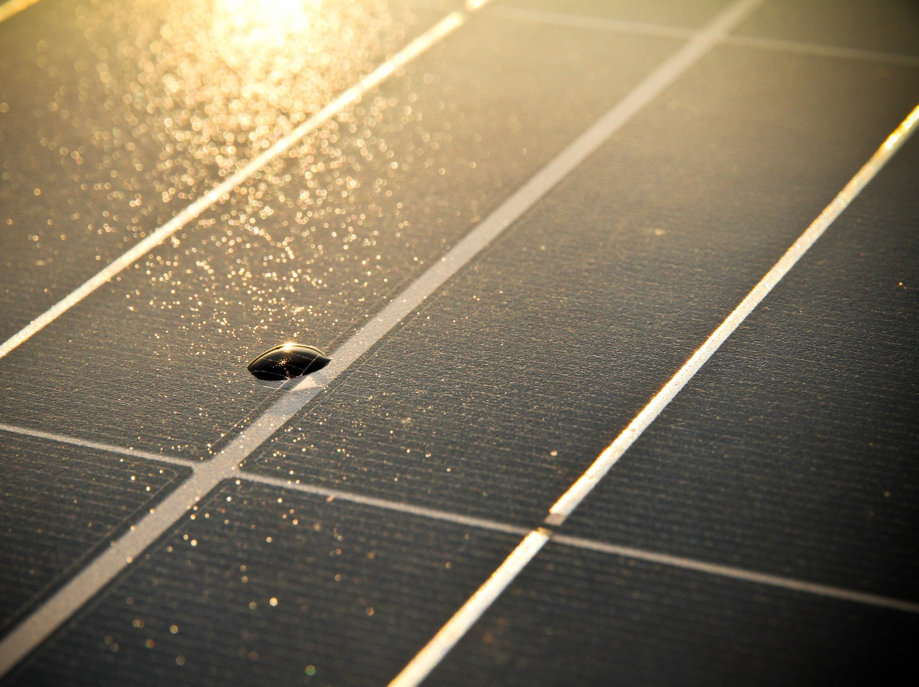

THANK YOU - QUESTIONS?
RESIDENTIAL SOLAR +
ENERGY STORAGE
BROUGHT TO YOU BY
Sylvie Briz Director of Marketing & Business Development Panasonic Eco Solutions Canada E: Sylvie.Briz@ca.Panasonic.com

